Slide 1
Section 11-3: Conditional Probability; Events Involving “And”
Apply the conditional probability formula.
Determine whether two events are independent.
Apply the multiplication rule for the event “A and B.”

Slide 2
Conditional Probability
Sometimes the probability of an event must be computed using the knowledge that some other event has happened (or is happening, or will happen – the timing is not important). This type of probability is called conditional probability.
The probability of event B, computed on the assumption that event A has happened, is called the conditional probability of B given A and is denoted P(B | A).

Slide 3
Example: Selecting From a Set of Numbers
From the sample space S = {2, 3, 4, 5, 6, 7, 8, 9}, a single number is to be selected randomly. Given the events
A: selected number is odd, and
B: selected number is a multiple of 3
find each probability.
a) P(B) B = {3, 6, 9}, so P(B) = 3/8
b) P(A and B) A and B = {3, 5, 7, 9}∩{3, 6, 9} = {3, 9}
so P(A and B) = 2/8 = 1/4
c) P(B | A) The given condition A reduces the sample space to {3, 5, 7, 9}, so
P(B | A) = 2/4 = 1/2

Slide 4
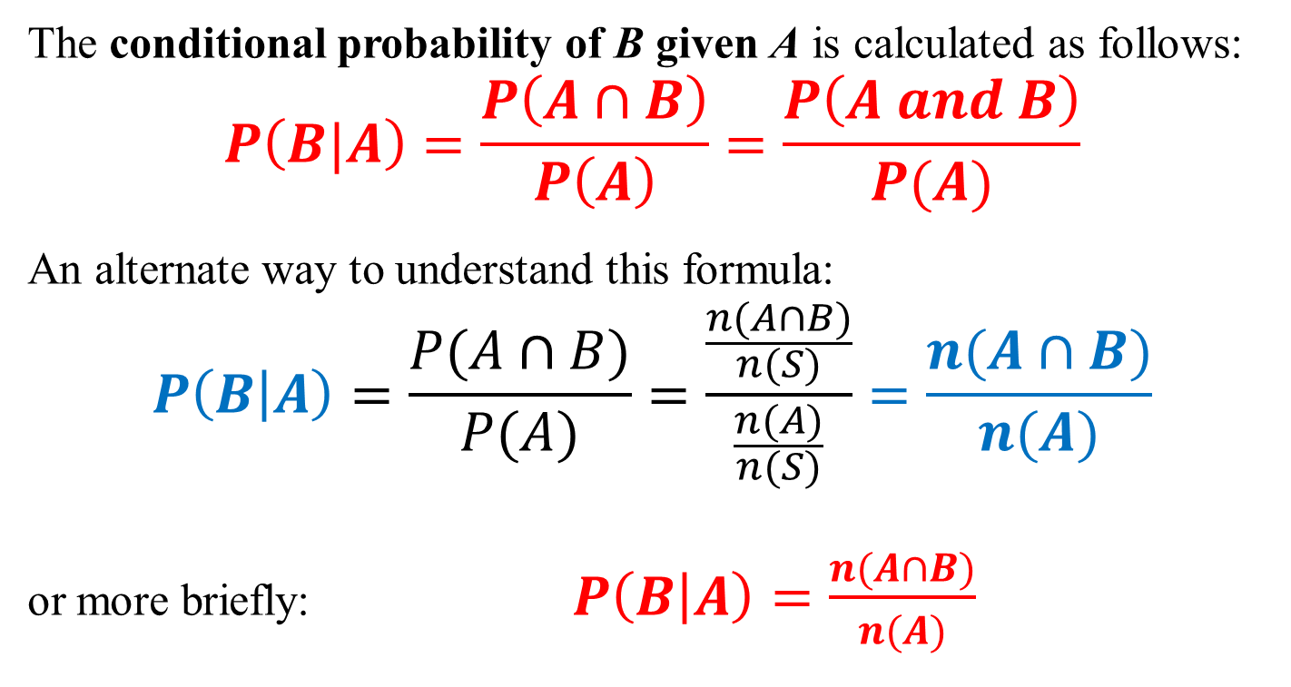
Conditional Probability Formula
The conditional probability of B given A is calculated as follows:
$$P\left(B|A\right)=\frac{P\left(A∩B\right)}{P\left(A\right)}=\frac{P\left(A and B\right)}{P(A)}$$
An alternate way to understand this formula:
$$P\left(B | A\right)=\frac{P(A∩B)}{P(A)}=\frac{\frac{n(A∩B)}{n(S)}}{\frac{n(A)}{n(S)}}=\frac{n(A∩B)}{n(A)}$$
or more briefly: $P\left(B | A\right)=\frac{n(A∩B)}{n(A)}$

Slide 5
Systematic Listing of a Sample Space
Suppose you had a family with four children.
Use a systematic method to list the sample space.
For each child, there are 2 possible choices (B or G). There are 2 ∙ 2 ∙ 2 ∙ 2 = 2⁴ = 16 different ways to have 4 children. We will keep track of the number of boys.
Four boys: BBBB
Three boys: BBBG, BBGB, BGBB, GBBB
Two boys: BBGG, BGBG, BGGB, GBBG, GBGB, GGBB
One boy: BGGG, GBGG, GGBG, GGGB
No boys: GGGG

Slide 6
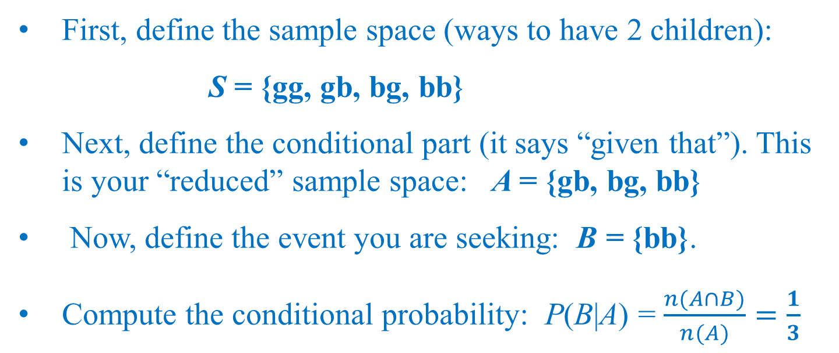
Example: Finding Probabilities of Boys and Girls in a Family
Given a family with two children, find the probability that both are boys, given that at least one is a boy.
First, define the sample space (ways to have 2 children):
S = {gg, gb, bg, bb}
Next, define the conditional part (it says “given that”). This is your “reduced” sample space: A = {gb, bg, bb}
Now, define the event you are seeking: B = {bb}.
Compute the conditional probability: P(B|A) = $\frac{n(A∩B)}{n(A)}=\frac{1}{3}$

Slide 7
Independent Events
Two events A and B are called independent events if knowledge about the occurrence of one of them has no effect on the probability of the other one, that is, if
P(B | A) = P(B), or equivalently P(A | B) = P(A).

Slide 8
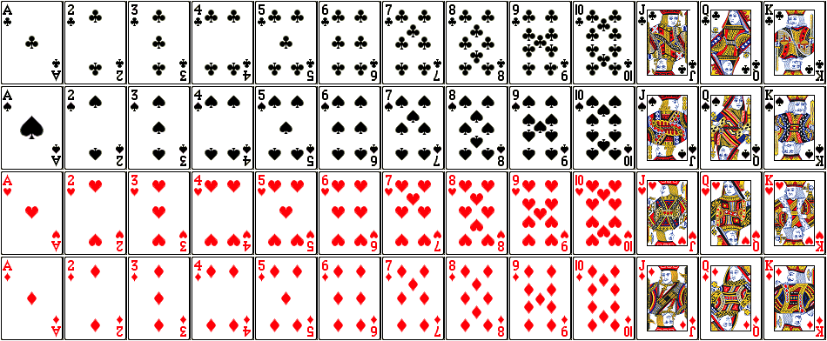
Example: Checking Events for Independence
A single card is to be drawn from a standard 52-card deck. Given the events
A: the selected card is an ace
B: the selected card is red
a) Find P(B).
b) Find P(B | A).
c) Determine whether events A and B are independent.

Slide 9
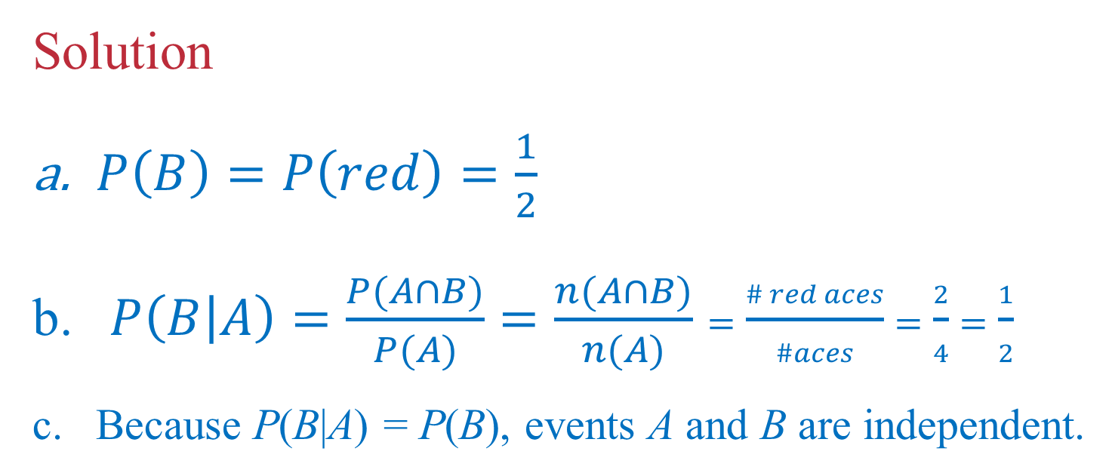
Example: Checking for Independence
Solution
$P\left(B\right)=P\left(red\right)=\frac{1}{2}$
$P\left(B | A\right)=\frac{P(A∩B)}{P(A)}=\frac{n(A∩B)}{n(A)}=\frac{\# red aces}{\#aces}=\frac{2}{4}=\frac{1}{2}$
Because P(B|A) = P(B), events A and B are independent.
A: selected card is an ace
B: selected card is red

Slide 10
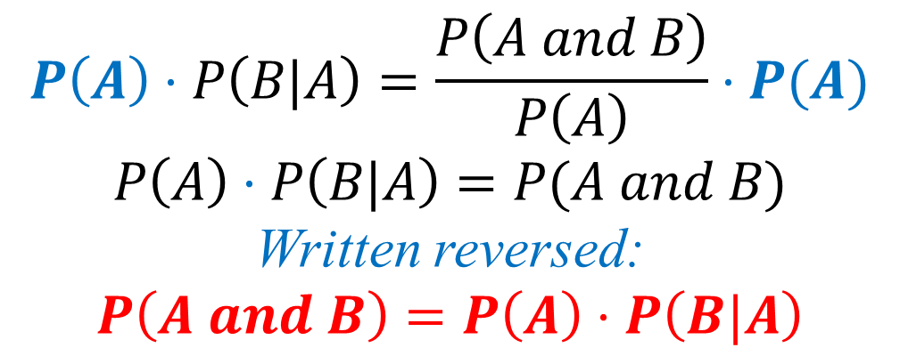
Events Involving “And”
If we multiply both sides of the conditional probability formula by P(A), we obtain an expression for P(A and B). The calculation of P(A and B) is simpler when A and B are independent.
Conditional Probability Formula
$$P\left(A\right)⋅P\left(B|A\right)=\frac{P\left(A and B\right)}{P\left(A\right)}⋅P(A)$$
$$P\left(A\right)⋅P\left(B|A\right)=P(A and B)$$
Written reversed:
$$P\left(A and B\right)=P\left(A\right)⋅P\left(B|A\right)$$

Slide 11
Multiplication Rule of Probability
If A and B are any two events, then
P(A and B) = P(A) ∙ P(B|A).
If A and B are independent, then
P(A and B) = P(A) ∙ P(B).

Slide 12
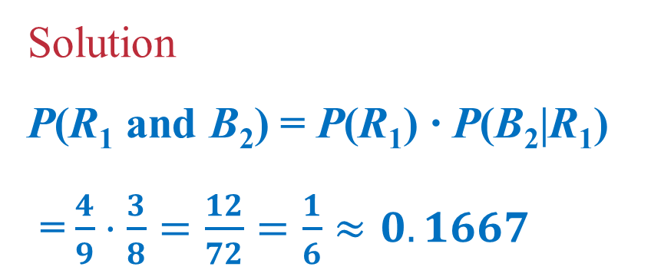
Example: Selecting From an Jar of Balls
Jeff draws balls from the jar below. He draws two balls without replacement. Find the probability that he draws a red ball and then a blue ball, in that order.
4 red
3 blue
2 yellow
Red first and Blue second
Solution
P(R₁ and B₂) = P(R₁) ∙ P(B₂|R₁)
= $\frac{4}{9}⋅\frac{3}{8}=\frac{12}{72}=\frac{1}{6}≈0.1667$

Slide 13
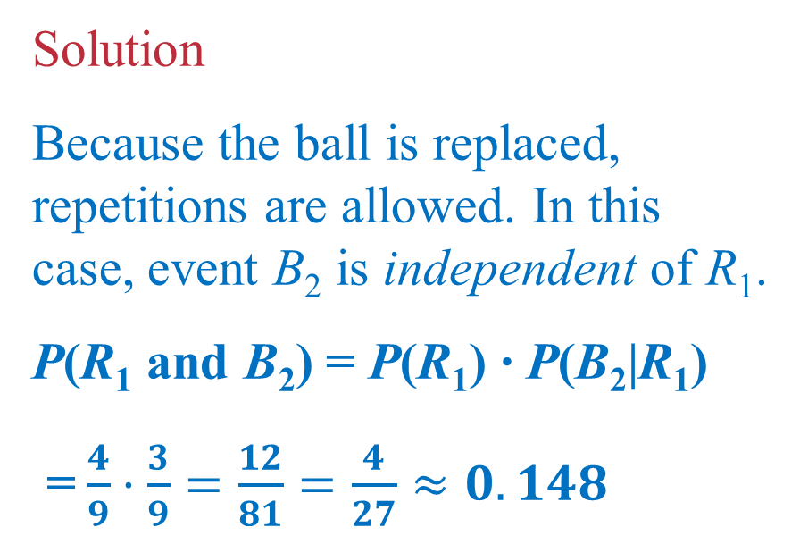
Example: Selecting From an Urn of Balls
Jeff draws balls from the jar below. He draws two balls, this time with replacement. Find the probability that he gets a red and then a blue ball, in that order.
Solution
Because the ball is replaced, repetitions are allowed. In this case, event B₂ is independent of R₁.
P(R₁ and B₂) = P(R₁) ∙ P(B₂|R₁)
= $\frac{4}{9}⋅\frac{3}{9}=\frac{12}{81}=\frac{4}{27}≈0.148$
4 red
3 blue
2 yellow

